Slide 1
EchoCalc
A Simple Voice Recognition Calculator

Slide 2

INTRODUCTION
In this presentation, we'll explore a simple voice calculator made with HTML, CSS, and JavaScript. We'll cover its basics, key features, and how we build it from scratch.

Slide 3
Voice Calculator Basics
01

Slide 4

What is a Voice Calculator?
A voice calculator is a web application that allows users to perform calculations using voice commands. Instead of typing numbers and operations, users can simply speak their inputs, making it intuitive and user-friendly.

Slide 5
What EchoCalc Can Do
ADDITION
SUBRACTION
MULTIPLICATION
DIVISION
SQUARE ROOT
LOGARITHMIC FUNCTIONS
FACTORIALS
DECIMAL CALCULATIONS
THEME CHANGE
HISTORY
MODULUS
PERCENTAGE
LARGE NUMBER CALCULATIONS

Slide 6
02
The Build Of EchoCalc

Slide 7
HTML Structure
Page Structure:
Language set to English (lang="en").
Head Section:
Sets metadata and responsive viewport.
Page title: 🔢EchoCalc.
Contains in-line CSS for styling and layout.
Body Overview:
Uses a background image and a semi-transparent theme overlay.
Responsive and centered layout using Flexbox.
Main Container:
Includes all UI elements.
Semi-transparent background with rounded corners and shadow for visual appeal.
Header:
Title and subtitle displayed using <h2> tags.
Input Section:
Text input box for manual math expression entry.
Handles "Enter" key for quick calculation.
Action Buttons:
Speak Now: Starts voice recognition.
Enter: Triggers calculation of typed input.
All Clear: Clears the input and result area.
Result Display:
Shows the calculated result or messages like voice transcript or error prompts.
History Panel:
Scrollable div that shows the last 10 calculation history items.
Theme Toggle:
Floating moon/sun button for light/dark mode switching.

Slide 8
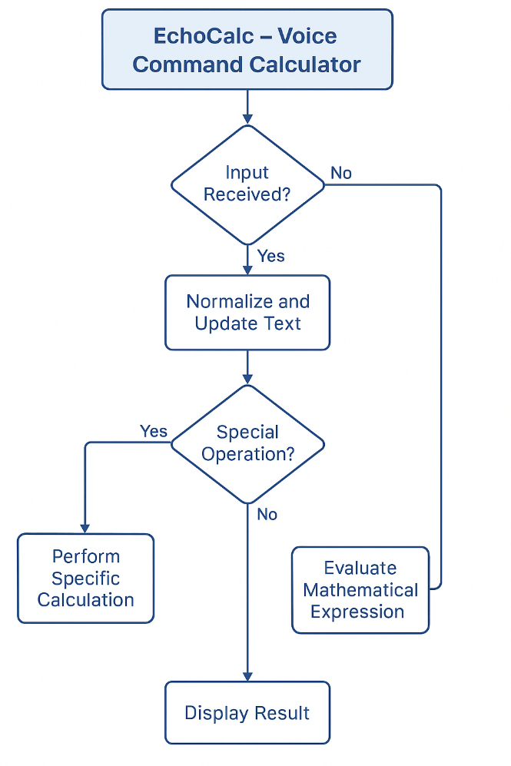
FLOW CHART

Slide 9
Styling with CSS
Modern visual Design
Background & contrast
Central Container Styling
Rounded corners and soft shadows
Semi-transparent white background for clarity
Interactive Buttons
Input Elements
Animations (blinking of mic)

Slide 10
JavaScript Interaction
Voice & Text Input
Speech Recognition
Natural Language Phrasing
Large Number Scale Support
Advance Calculations
Expression Evaluation
Speech Synthesis
Input & Output Handling

Slide 11
Uses of EchoCalc
Hands-free Calculation: Allows users to perform calculations using voice commands—ideal for multitasking or accessibility.
Natural Language Processing: Understands spoken math queries like “100 million plus 5 billion,” eliminating the need for manual input.
Educational Tool: Assists students in learning math by speaking both the input and output, enhancing auditory learning.
Quick Everyday Calculations: Useful for day-to-day arithmetic, unit conversions, and large number handling without needing a scientific calculator.
Accessible Interface: Designed to be easy for users with visual impairments or mobility challenges.

Slide 12
Conclusions
EchoCalc combines voice recognition with smart mathematical parsing to offer a user-friendly, hands-free calculator experience. From basic arithmetic to advanced functions like factorials and logarithms, it simplifies calculations through both speech and text making math more accessible and interactive.

Slide 13
Thank you!
Presented by:
Aswin N
Aathi Sathguru M

